Slide 1
Pattern-based Group Presentation
JIACHENG LI 10307457
ZONGCHEN YU 10310004
WENJIE LUO 10141127

Slide 2
Brief description
This application is used for word analyzation of politicians in twitter. When user enter his/her username or password, it will redirect into the politician page, which user could choose one or more politicians. Once clients choose the person, this will load and show data from Twitter. Statistics in this application can be sorted and filtered. Moreover, user can get the statistics analysis results based on current state.

Slide 3
Show programe

Slide 4
MVC Overview
When it comes to MVC pattern, it is necessary to have this pattern whereas it may take long time for separation of model, view and controller. We need MVC pattern since objects can clearly perform which task they could do. MVC makes code more reusable and easier to modify when requirements changed. Although in the early time, it can save time, but developers will spend more time on meeting changeable requirements and bug fixing. Overall, this pattern is a good solution.

Slide 5
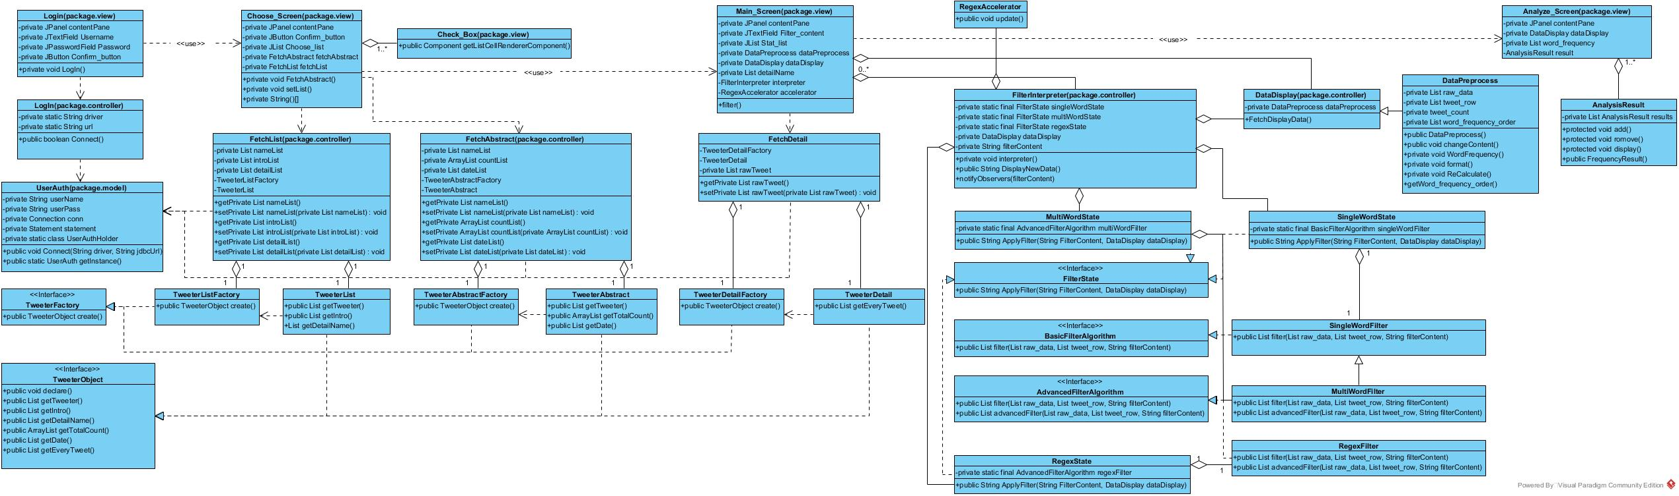
View in MVC

Slide 6
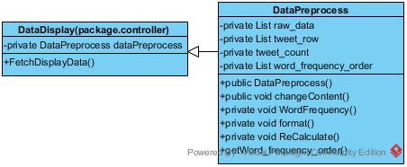
Adapter Pattern
The purpose of adapter pattern is to solve the problems of transfer the format of tweets to make the clearer to see in the screen page. The advantage is that using this pattern can make the tweets data compatible. If this pattern is not used, a new class needed to be implemented in order to make the data compatible to current program. Therefore, using adapter pattern is the best solution.

Slide 7
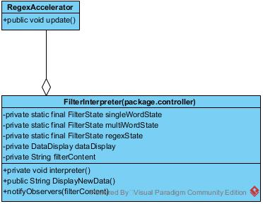
Observer Pattern
We use observer pattern to monitor the state of filter word, once it changes the state, this can be notified. Multiple tests can be used to authenticate if program meets the requirements. Therefore, use this pattern can save the cost.

Slide 8
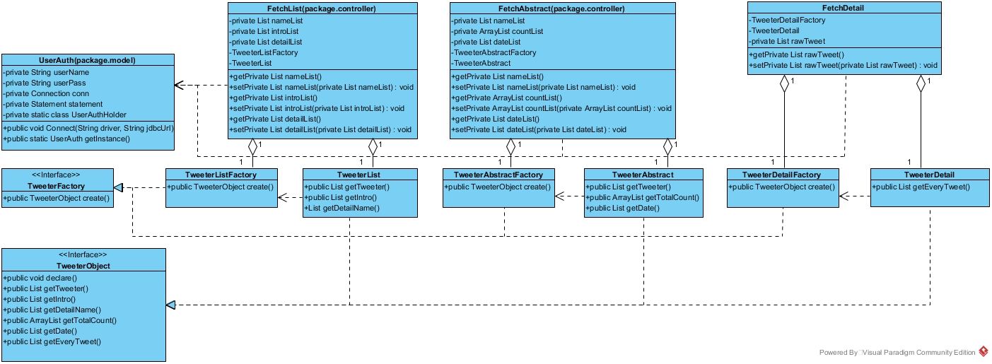
Model in MVC

Slide 9
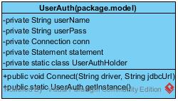
Singleton Pattern
The purpose of singleton pattern is to ensure this instance could only be created from this method of that class so that other classes instantiate it via that constructor. For Singleton pattern, it points to control each class can only have one object. Moreover, object can only be created from that public method in the class. For example, in this application, UserAuth class can save memory for database connecting. Whereas in UserAuth class, it has some objects, only single object could be created. It is not necessary to use Singleton pattern since this program is not a big application. Meanwhile, this program does not consume a lot of memories for database connection. Thus, it makes little difference whether use the Singleton pattern or not.

Slide 10
Abstract Factory Pattern
The aim of abstract factory pattern is to instantiate TweeterObject which has different types of TwitterObject like tweeterabstract, tweeterdetail and tweeterlist that object creation can change without the effect of creation method. Therefore, once a specific object needs to be created, we just need to use that factory class. Without this pattern, this application can still be implemented. However, it will make code redundant and increase the abstract complexity of software. Therefore, no better solution can be used unless this pattern is applied.

Slide 11
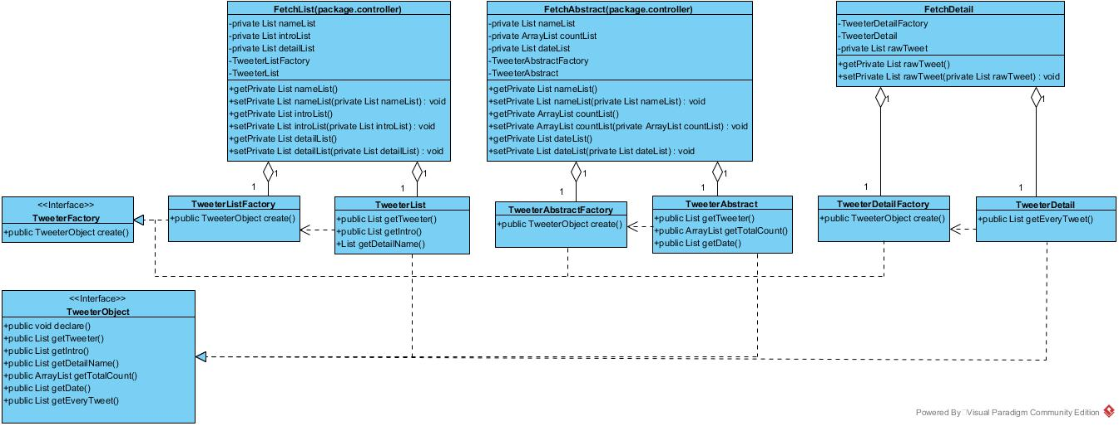

Slide 12
Controller in MVC

Slide 13
Strategy Pattern
The aim of utilizing strategy is to switch the interchangeable search algorithms without using a lot of switch sentences in a class. Strategy pattern can be replaced with using State pattern. The advantages of State pattern are approximately similar to the Strategy pattern while State pattern needs to define all states at beginning. Changing states can be more flexible and easier when using State pattern. Comparatively, strategy pattern can be easier for implementation and meets the principles of low coupling.

Slide 14
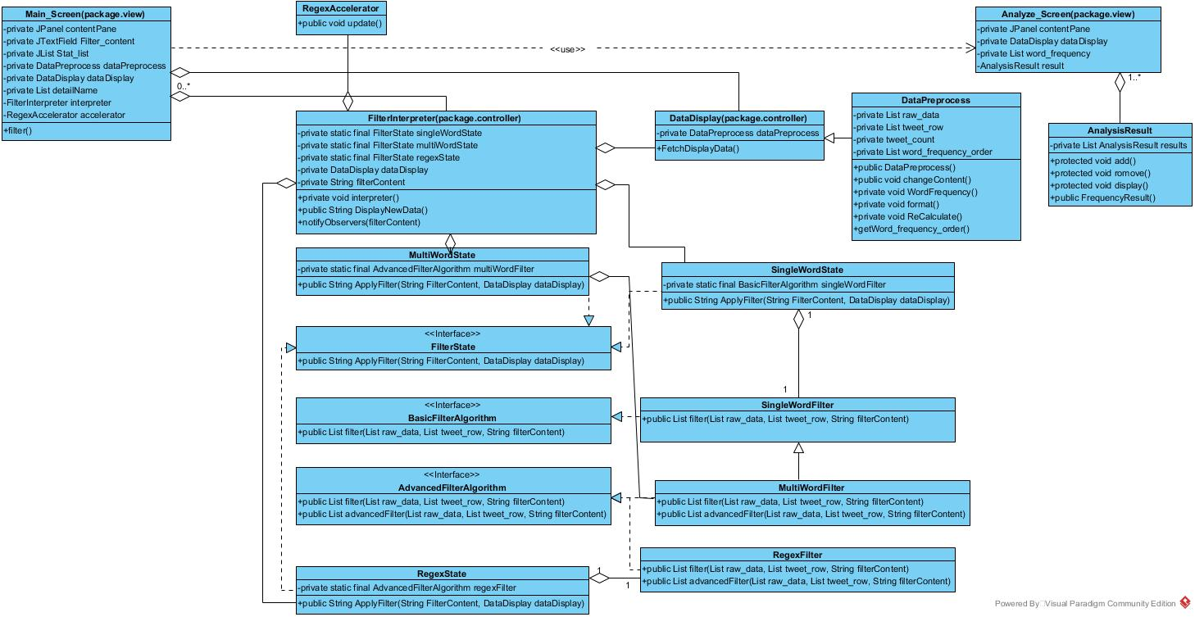

Slide 15
Decorator Pattern
For decorator pattern, it aims to add more function to the existing object. In this case, decorator is designed to add more filter conditions. Decorator pattern is more flexible than inheritance. We could use inheritance instead of decorator pattern, high flexibility means more options which can make program error-prone. However, decorator pattern is also a good choice on the level of code reuse.

Slide 17
Composite Pattern
Considering composite pattern, this can clearly show the hierarchy and composite among components and classes. Adding new component is easy. For users, the call of high-level modules is simple as users do not need to consider the processing of low-level modules, which means it is difficult to manage the whole part. We can use simple object composition method to replace composite pattern, but it can make the program structure complex. Thus, using composite pattern could be better.

Slide 19
Relationships among patterns
Each pattern has different relationships based on the implementations and functions.
Strategy pattern has an aggregation relationship with decorator pattern.
The method “notifyObservers(filterContent)” and class RegexAccelerator fulfill observer pattern, which associates with strategy pattern.
Class Datadisplay performs the adapter pattern that has an aggregation relationship with strategy pattern.
Strategy pattern has dependency on composite pattern.
Singleton pattern implemented in class UserAuth has dependency on Abstract Factory pattern.
Abstract Factory pattern associates with other patterns.
MVC contains above patterns.

Slide 20
Thank you.
Any Questions?

